Slide 1



1 How to traverse files & subfolders of given directory??
#javainterview

Slide 2

2 How to traverse files & subfolders of given directory??
#javainterview
#javarefreshed

Slide 3
PURPOSE
Solving real time programming problems
Using Java API only, no 3rd party library
Using and exploring latest java features
Focusing on interview type questions
By the time we will have good java interview question bank

Slide 4
How to filter specific files while reading from given directory??
#javainterview

Slide 5
How to read big size files efficiently?
#javainterview

Slide 6
What is the Role of Class loader
#javainterview

Slide 7
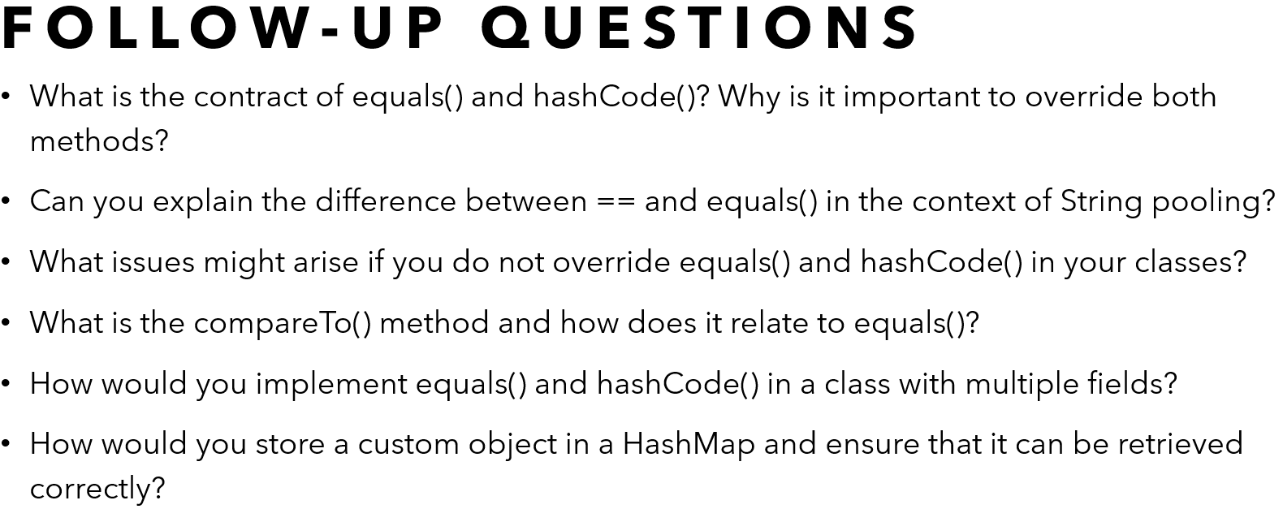
Explain the difference between == and equals() in Java. **all related questions covered
#javainterview#codefarm

Slide 8
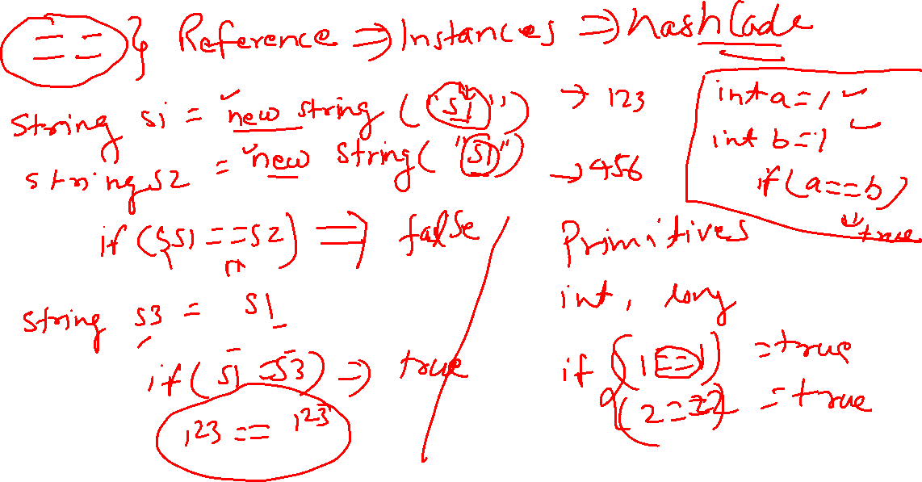

Slide 9
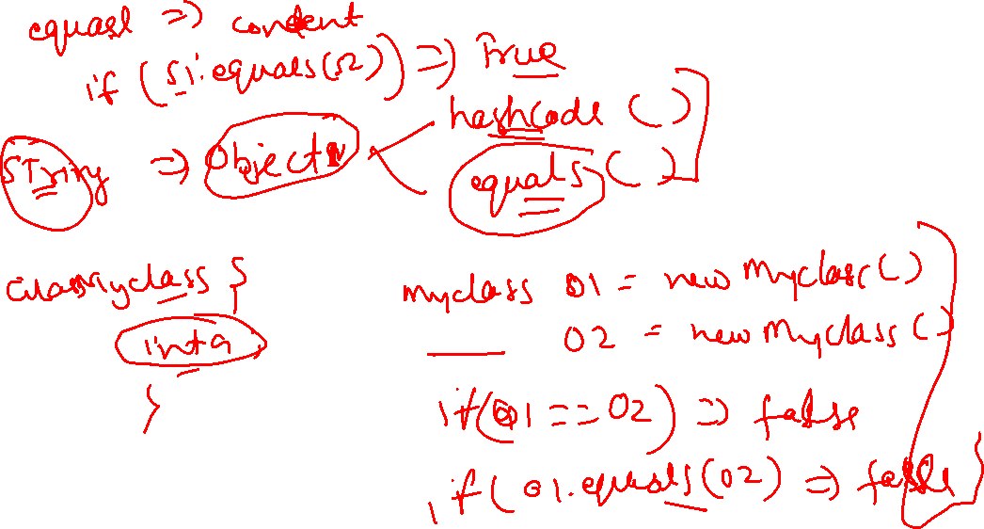

Slide 10
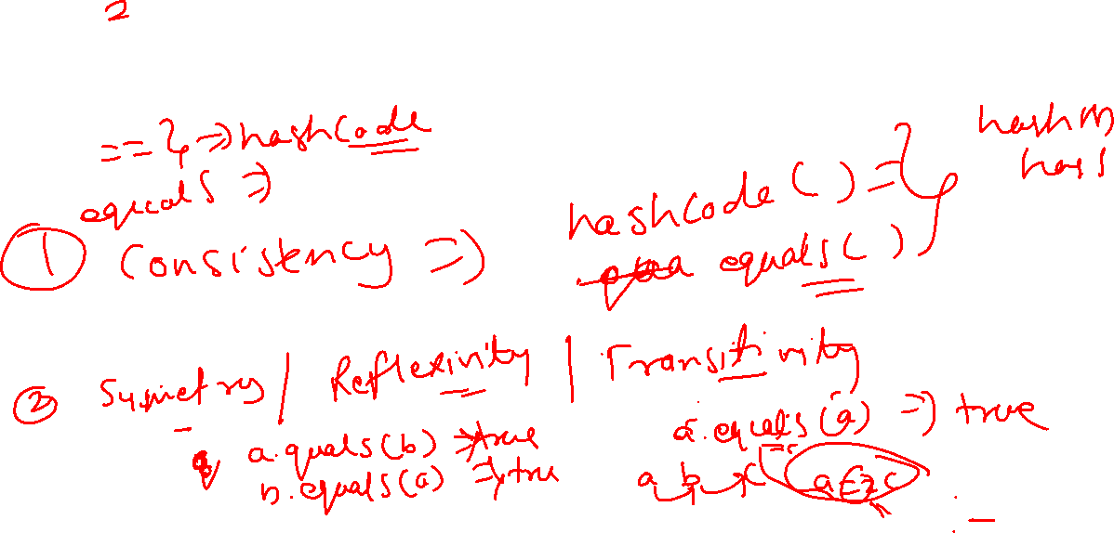
Best Practices

Slide 11
Follow-Up Questions
What is the contract of equals() and hashCode()? Why is it important to override both methods?
Can you explain the difference between == and equals() in the context of String pooling?
What issues might arise if you do not override equals() and hashCode() in your classes?
What is the compareTo() method and how does it relate to equals()?
How would you implement equals() and hashCode() in a class with multiple fields?
How would you store a custom object in a HashMap and ensure that it can be retrieved correctly?

Slide 12
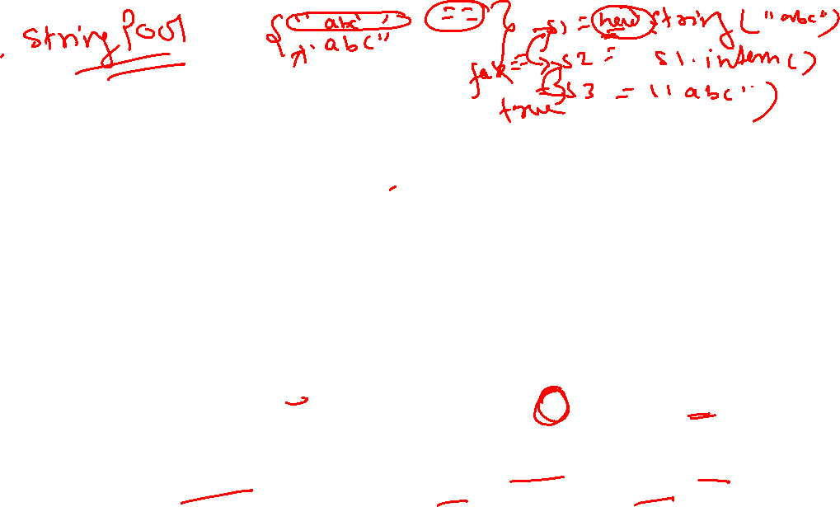
Related Concepts
String Interning: Understanding how String interning works and how it affects the == operator with strings.
Immutability: Discussing immutable objects and how equals() and hashCode() are typically implemented for them.
Comparable vs Comparator: The difference between the Comparable interface (which includes compareTo()) and the Comparator interface (which includes compare()) and their roles in sorting and ordering objects.
Identity HashMap: A specialized Map implementation that uses == instead of equals() for key comparison.
Deep vs Shallow Comparison: Understanding the difference between deep comparison (comparing the contents of the objects recursively) and shallow comparison (comparing references).

Slide 13
What are the main principles of Object-Oriented Programming (OOP)? **all related questions covered
#javainterview#codefarm

Slide 16
Related concepts
Classes & Objects
Methods
Attributes
Constructor
Access Modifiers
Interface
Abstract Class

